Slide 1
6. Heapsort

Slide 2
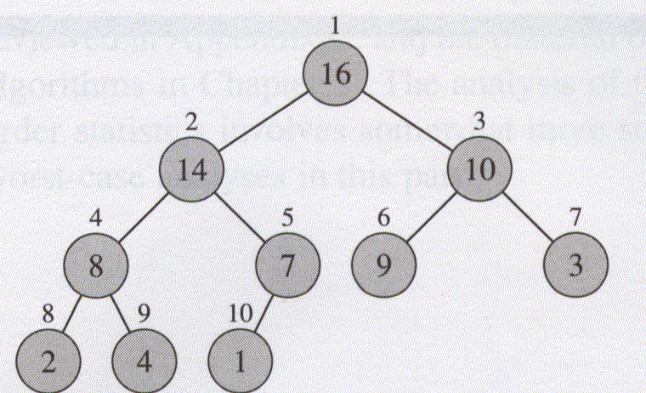
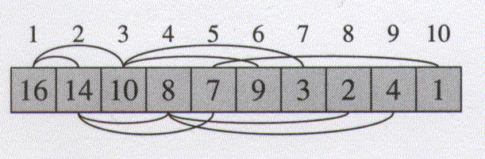
6.1 Heaps (Binary heap)
The binary heap data structure is an array object that can be viewed as a nearly complete binary tree.
Parent(i)
return
LEFT(i)
return 2i
Right(i)
return 2i+1

Slide 3
Heap property
Max-heap : A[parent(i)] ≥ A[i]
Min-heap : A[parent(i)] ≤ A[i]
The height of a node in a tree: the number of edges on the longest simple downward path from the node to a leaf.
The height of a tree: the height of the root
The height of a heap: O(lg n).

Slide 4
Basic procedures on heap
MAX-HEAPIFY procedure
BUILD-MAX-HEAP procedure
HEAPSORT procedure
MAX-HEAP-INSERT procedure
HEAP-EXTRACT-MAX procedure
HEAP-INCREASE-KEY procedure
HEAP-MAXIMUM procedure
O(lgn)
O(n)
O(nlgn)
O(lgn)
O(lgn)
O(lgn)
Θ(1)

Slide 5
6.2 Maintaining the heap property
HEAPIFY() is an important subroutine for manipulating heaps. Its inputs are an array A and an index i into the array. When HEAPIFY() is called, it is assumed that the binary trees rooted at LEFT(i) and RIGHT(i) are heaps, but that A[i] may be smaller than its children, thus violating the heap property.

Slide 6
MAX-HEAPIFY(A, i)
1 l → LEFT(i)
2 r → RIGHT(i)
3 if l ≤ heap-size[A] and A[l] > A[i]
4 then largest ← l
5 else largest ← i
6 if r ≤ heap-size[A] and A[r] > A[largest]
7 then largest ← r
8 if largest ≠ i
9 then SWAP(A[i], A[largest])
10 MAX-HEAPIFY(A, largest)
Alternatively O(h) (h: height)

Slide 7
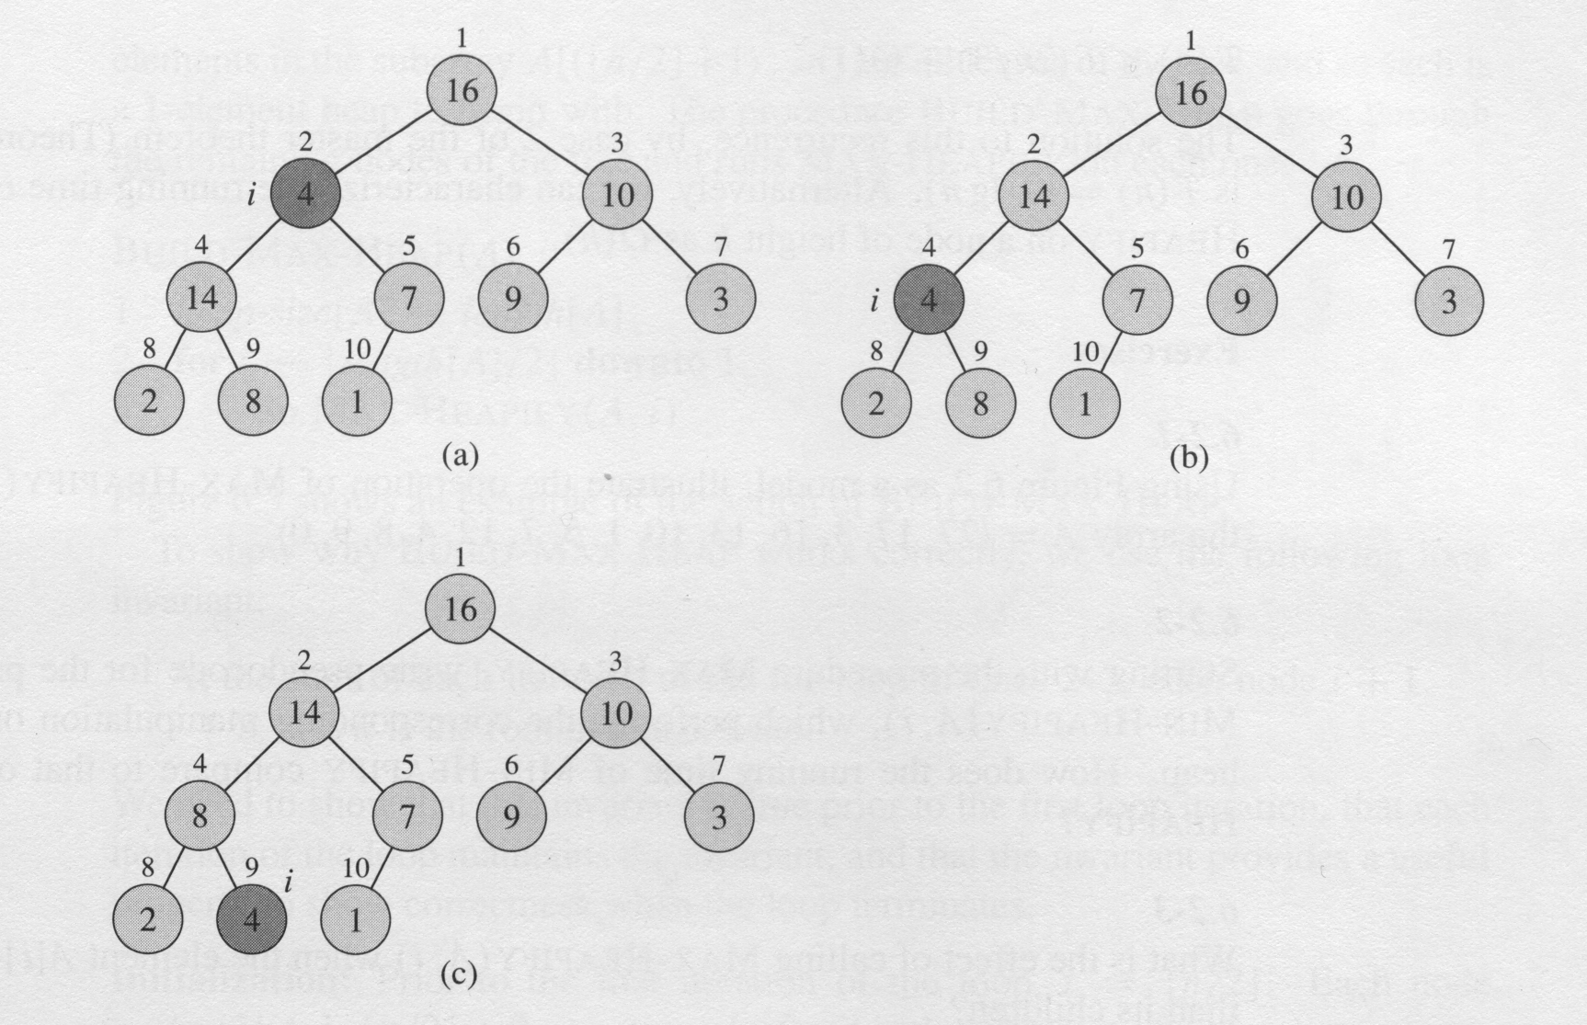
MAX-HEAPIFY(A, 2) heap-size[A] = 10

Slide 8
6.3 Building a heap
BUIDE-MAX-HEAP(A)
1 heap-size[A] ← length[A]
2 for i ← ⎣length[A]/2⎦ downto 1
3 do MAX-HEAPIFY(A, i)

Slide 9
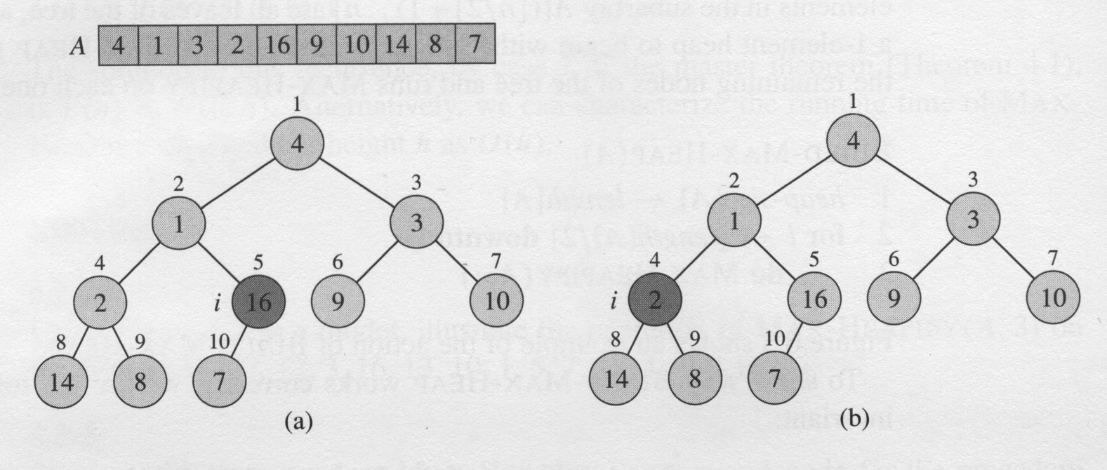
An example of BUILD-MAX-HEAP

Slide 10
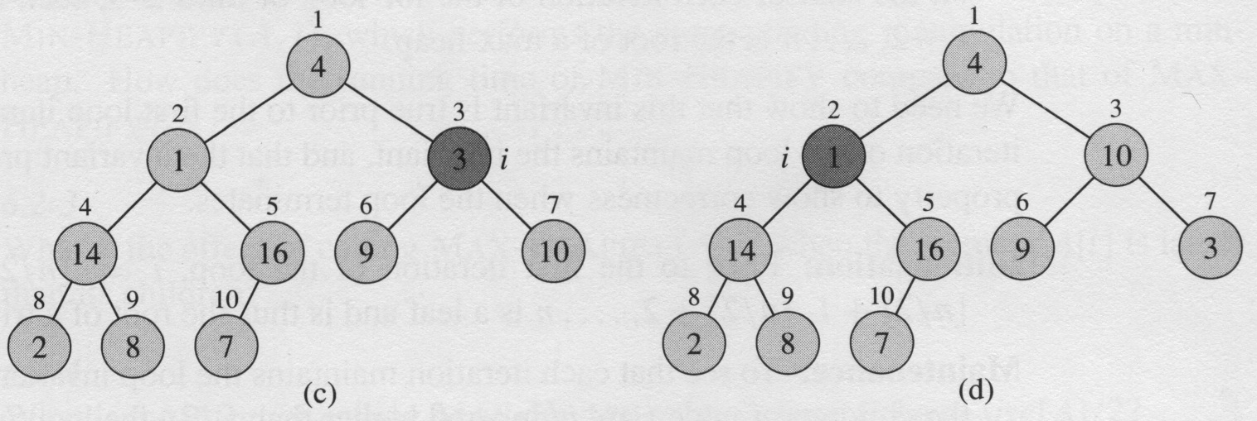
An example of BUILD-MAX-HEAP (II)

Slide 11
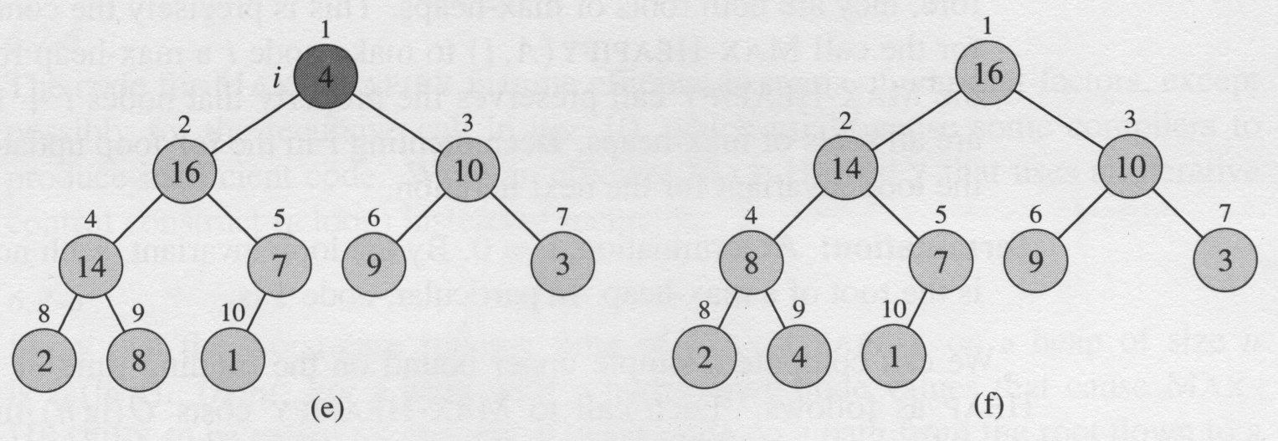
An example of BUILD-MAX-HEAP (III)

Slide 13
6.4 The Heapsort algorithm
HEAPSORT(A)
1 BUIDE-MAX-HEAP(A)
2 for i ← length[A] downto 2
3 do SWAP(A[1], A[i])
4 heap-size[A] ← heap-size[A] – 1
5 MAX-HEAPIFY(A,1)
Complexity: O(nlgn)

Slide 14
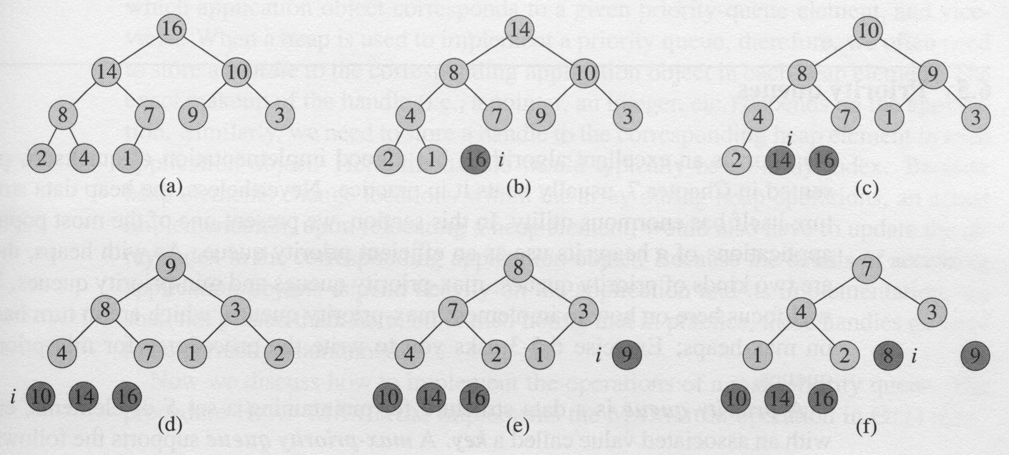
The operation of HEAPSORT()

Slide 15
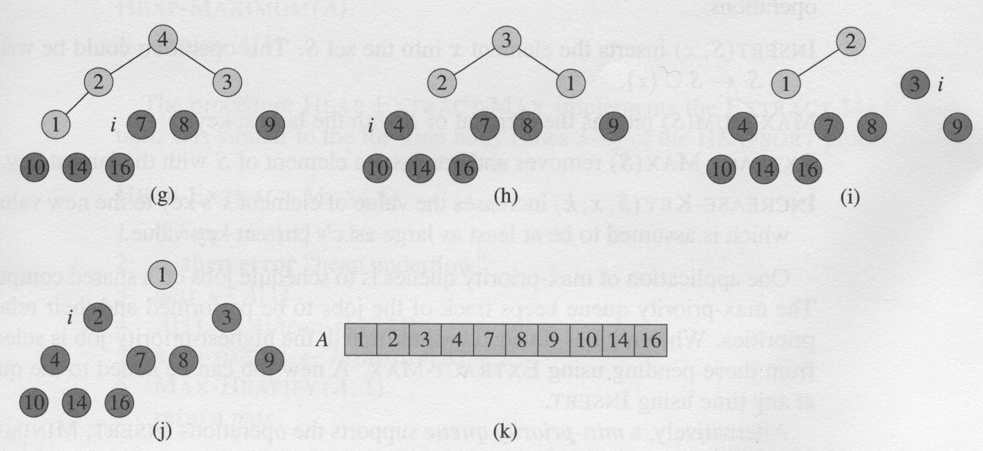
The operation of HEAPSORT() (cont.)
Analysis: O(n logn)

Slide 16
6.5 Priority queues
A priority queue is a data structure that maintains a set S of elements, each with an associated value called a key. A max-priority queue support the following operations:
Insert (S, x) O(log n)
Maximum (S) O(1)
Extract-Max (S) O(log n)
Increase-Key (S, x, k) O(log n)

Slide 17
HEAP-EXTRACT-MAX(A)
1 if heap-size[A] < 1
2 then error “heap underflow”
3 max ← A[1]
4 A[1] ←A[heap-size[A]]
5 heap-size[A] ← heap-size[A] – 1
6 MAX-HEAPIFY(A, 1)
7 return max
Complexity: O(log n)

Slide 18
HEAP-INCREASE-KEY(A, i, key)
1 if key < A[i]
2 then error “new key is smaller than current key”
3 A[i] ← key
4 while i > 1 and A[Parent(i)] < A[i]
5 do SWAP(A[i], A[Parent(i)])
6 i ← Parent(i)
Complexity: O(log n)

Slide 19
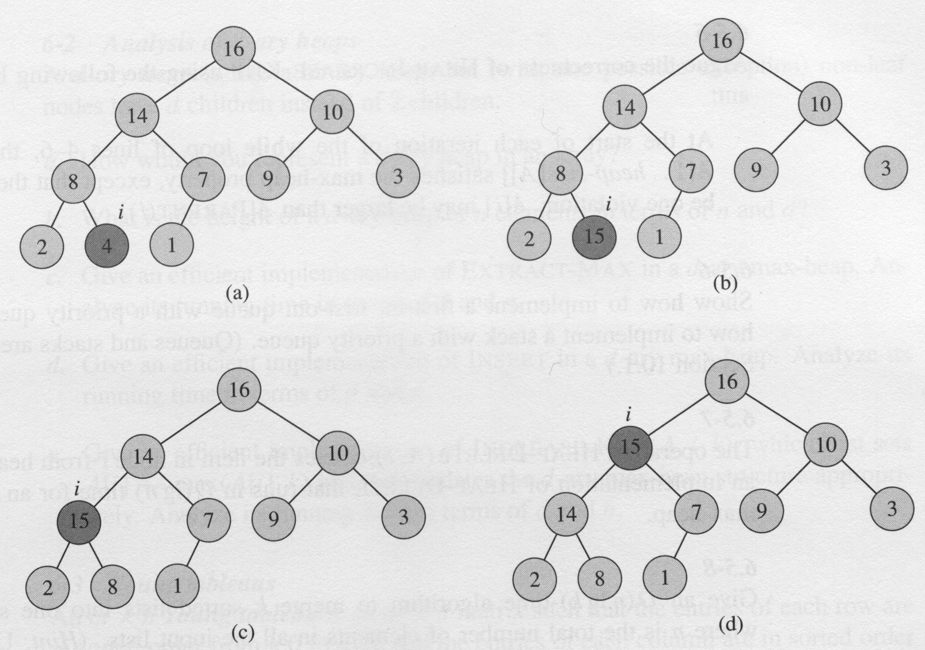
HEAP-INCREASE-KEY

Slide 20
HEAP-INSERT(A, key)
1 heap-size[A] ← heap-size[A] + 1
2 A[heap-size[A]] ← -∞
3 HEAP-INCREASE-KEY(A, heap-size[A], key)
Complexity: O(log n)

